Slide 1
The Tortoise and the Hare
The Race for Slow Food

Slide 2
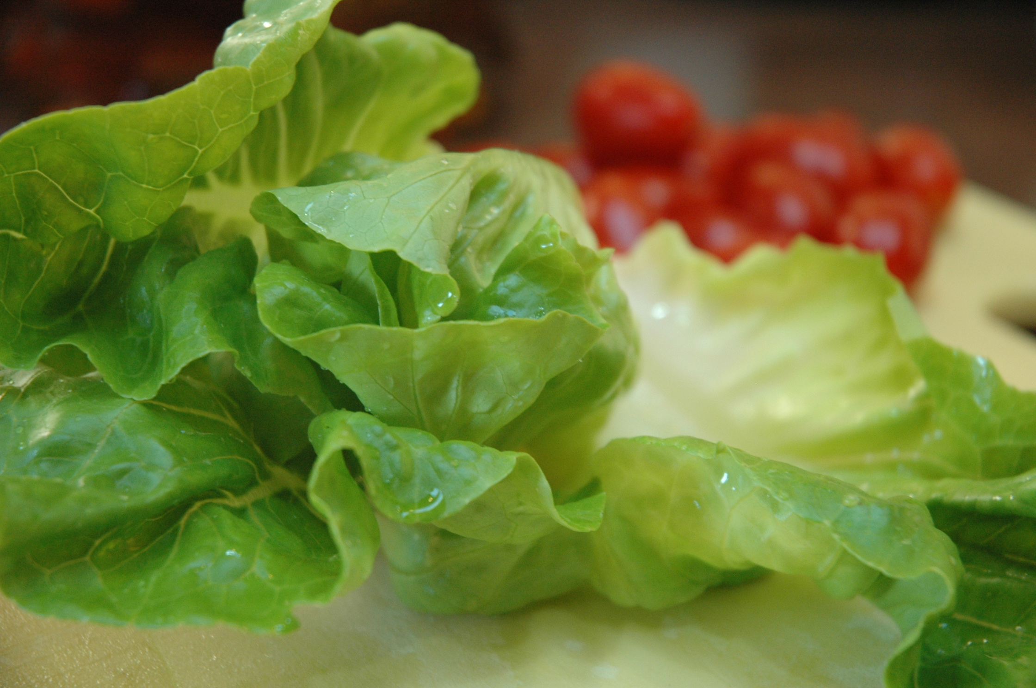

Slide 3
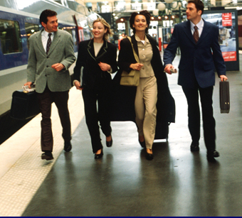
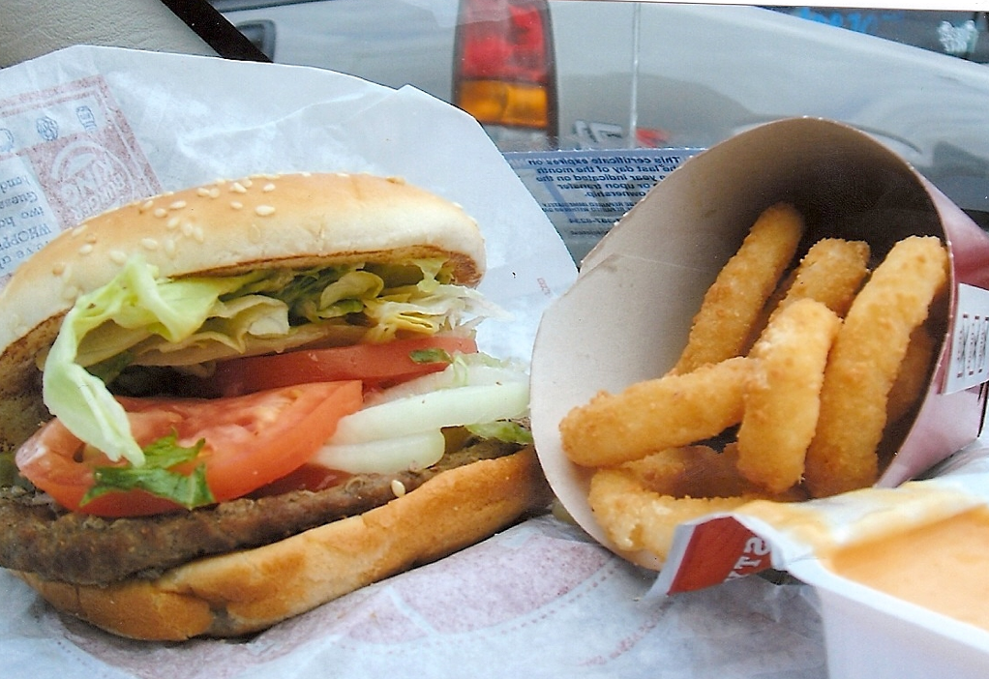
Fast Lifestyles
Google Images
Fast Food
Google Images

Slide 4
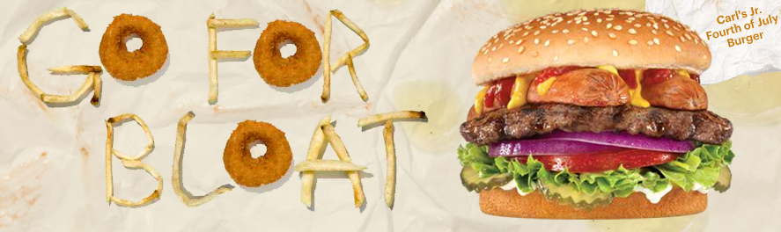
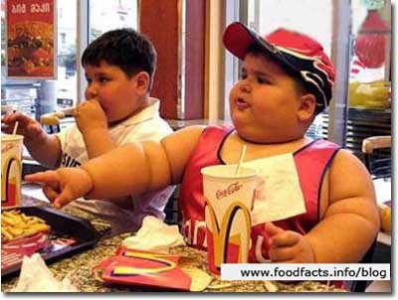
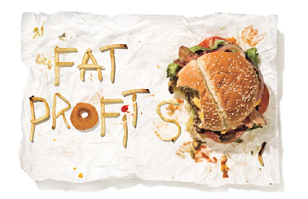

Slide 5
“It’s bizarre that the produce manager is more important to my children’s health than the pediatrician.”
Meryl Streep

Slide 6

Slow Food
Health
The Beginning
The Local Visionaries

Slide 7
“The federal government has sponsored research that has produced a tomato that is perfect in every respect, except that you can’t eat it.
We should make every effort to make sure this disease, often referred to as ‘progress’ doesn’t spread.”
Andy Rooney

Slide 8
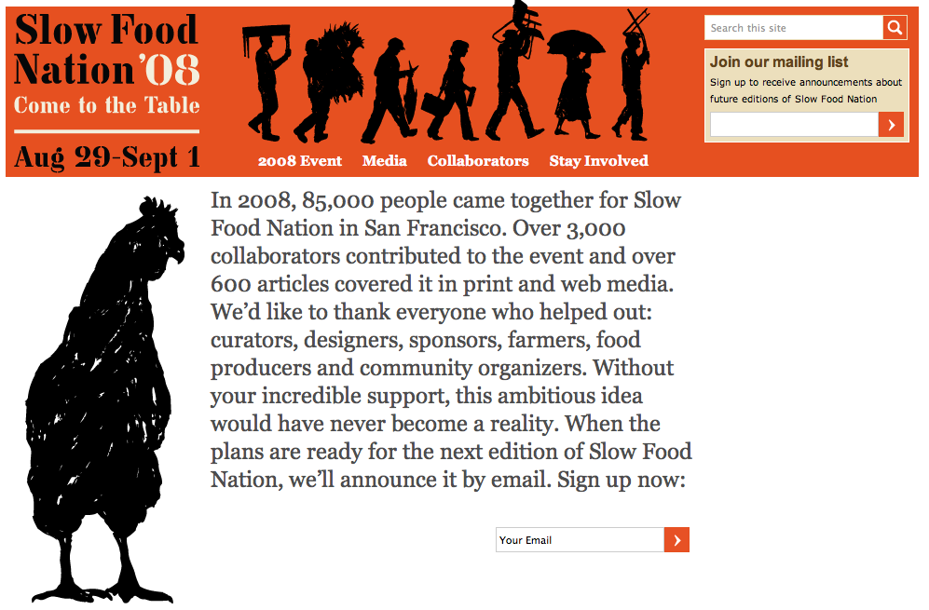

Slide 9

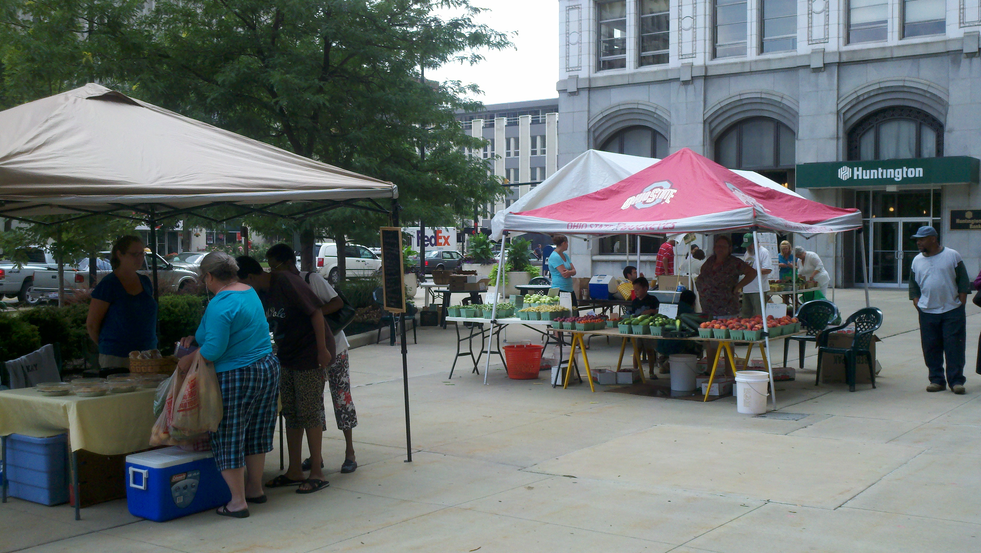
Local Visionaries
Google Images

Slide 10
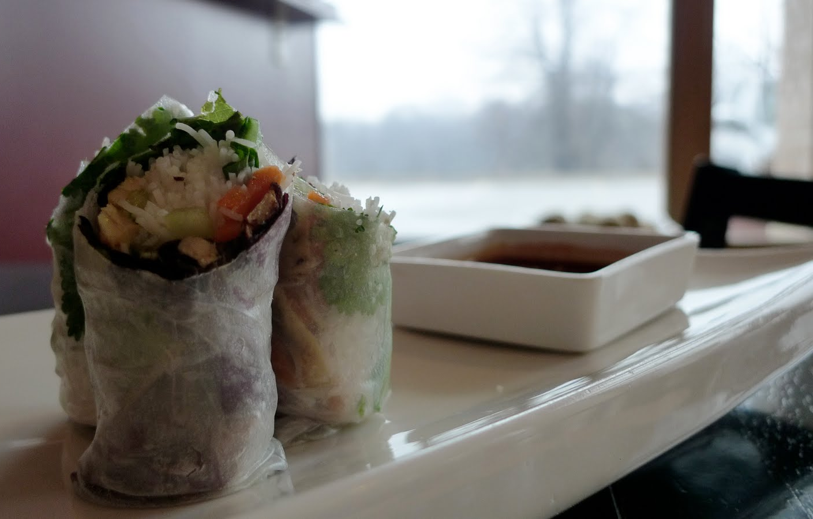
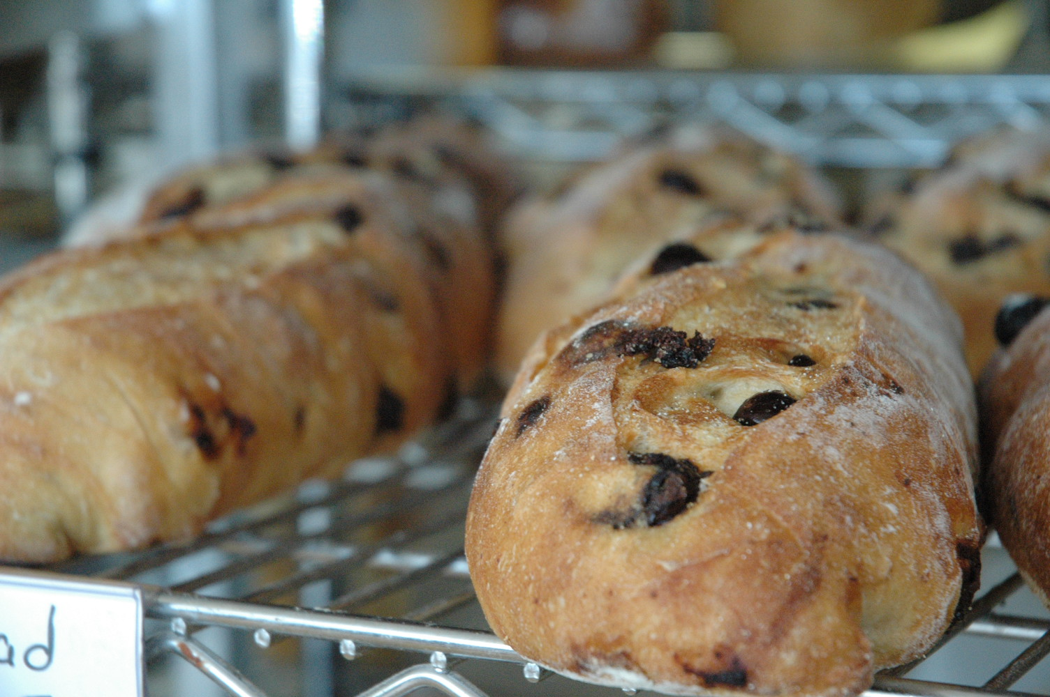
Local
Visionaries

Slide 11
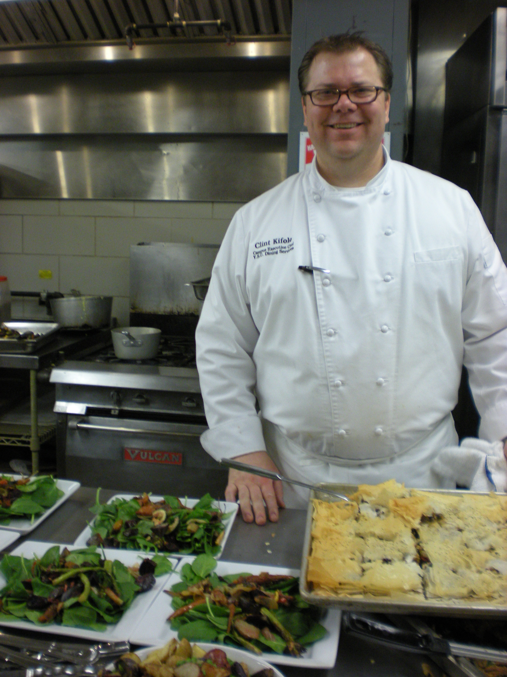

Local
Visionaries

Slide 12
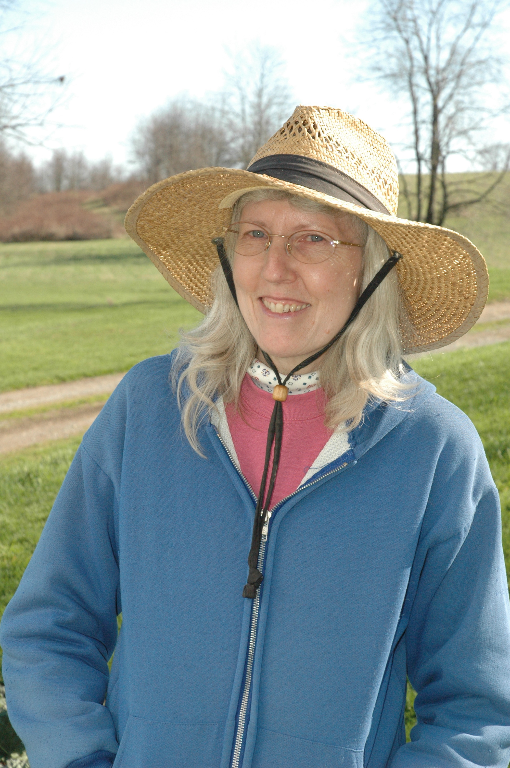
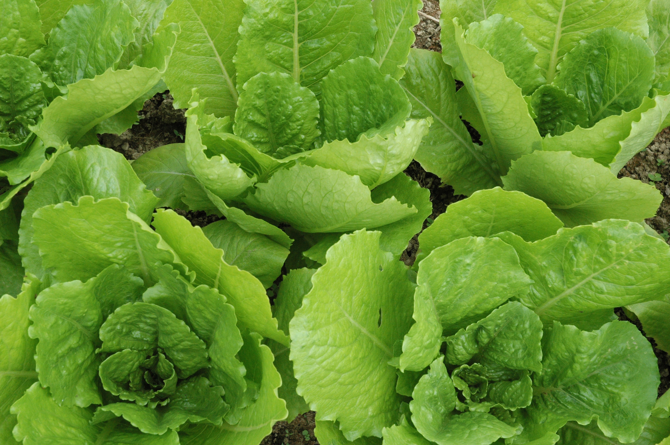
Local
Visionaries

Slide 13
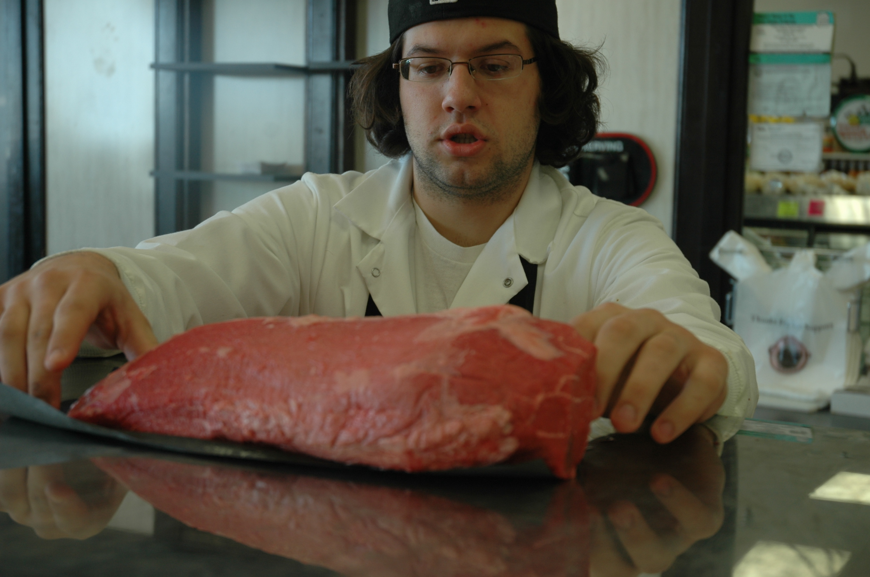
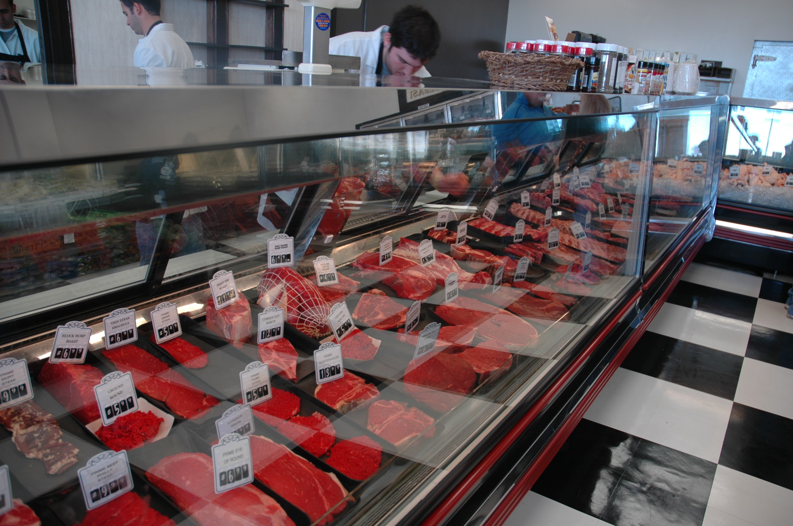
Local
Visionaries

Slide 14
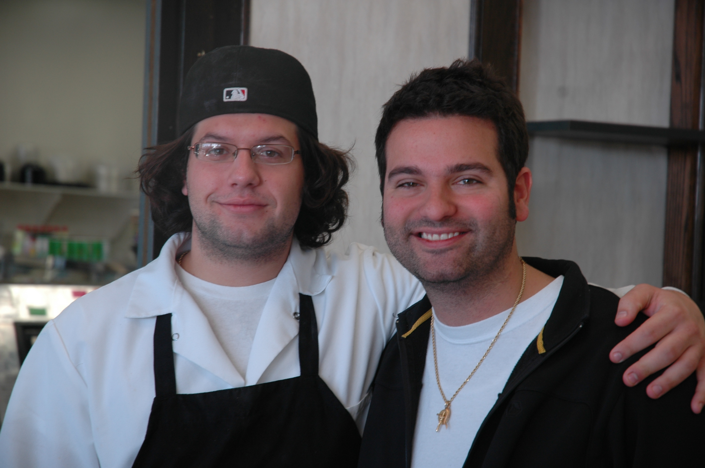
Joe Polis and Dan Catullo

Slide 15
Current statistics reveal there are over 98 million Americans classified as obese and overweight, which accounts for more than 85% of all diabetes cases.
Steven Arnold, Obesity Statistics

Slide 16
Review
Fast-paced lifestyle
Local sustainable resources
Local Visionaries
Obesity and Disease

Slide 17
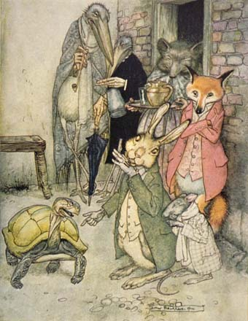
“Slowly does it every time… says the turtle to the hare on winning the race.”
Google Images
Aesop’s Fables, The Tortoise and the Hare

Slide 18
You really can change the way America eats … one bite at a time.

