Slide 1
FOOD FOR THOUGHT
A look at the science of
genetically modified organisms

Slide 2
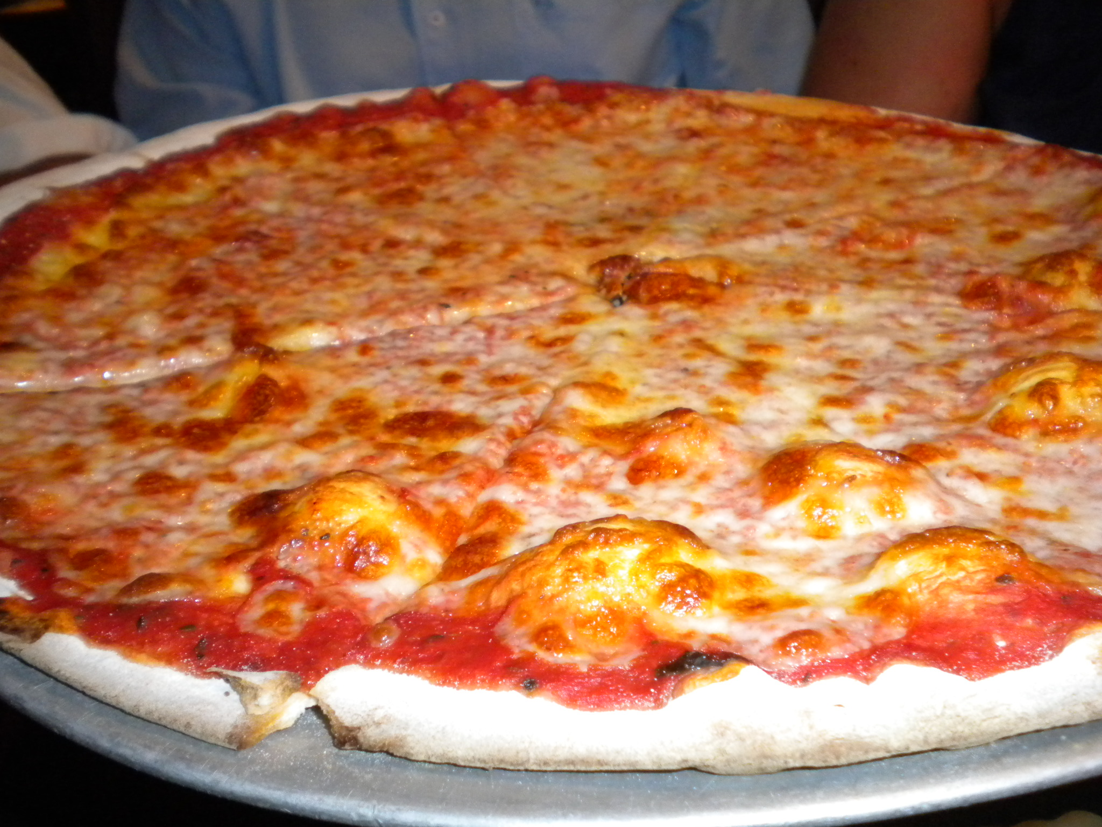
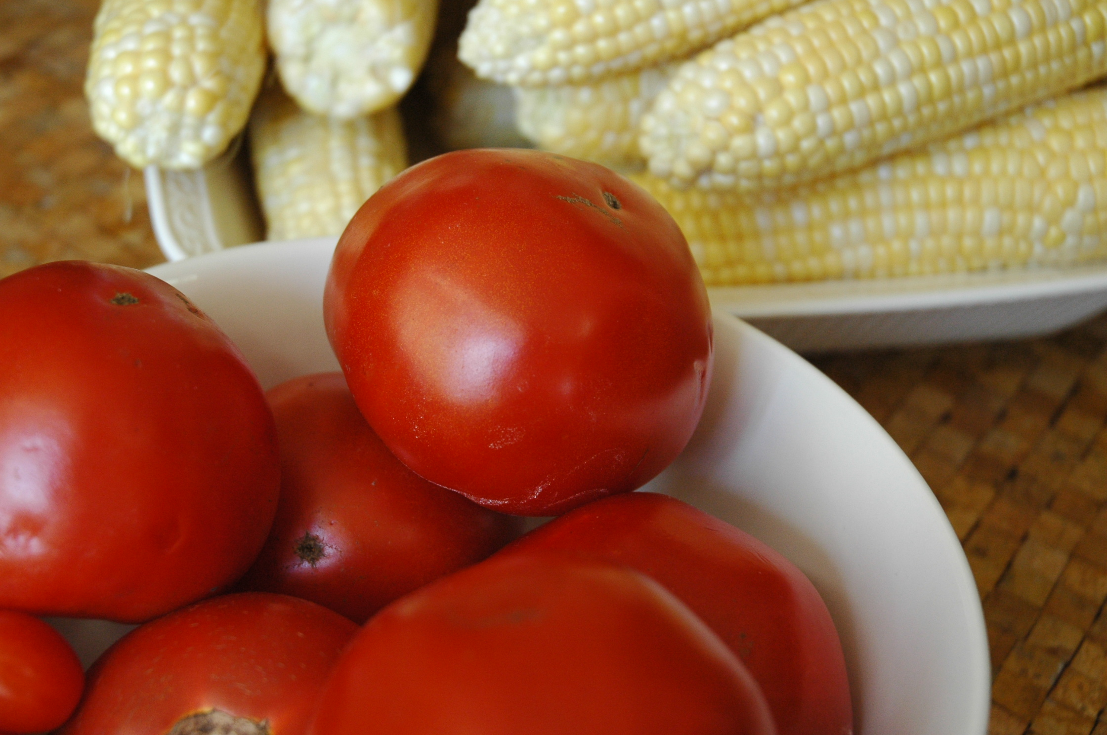
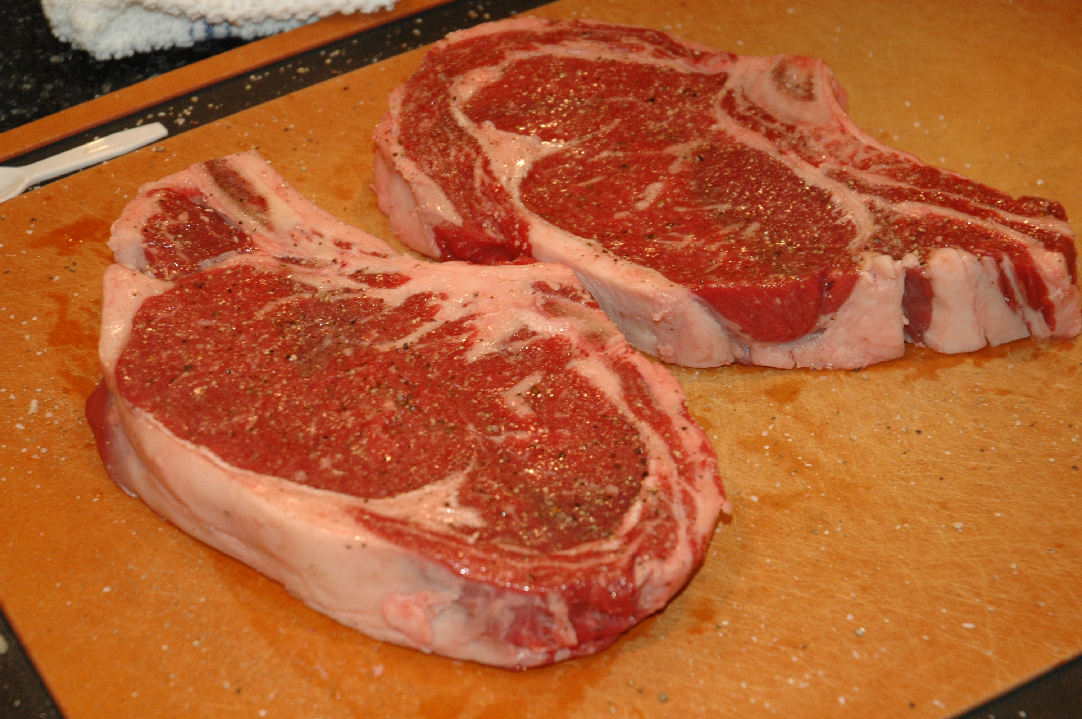
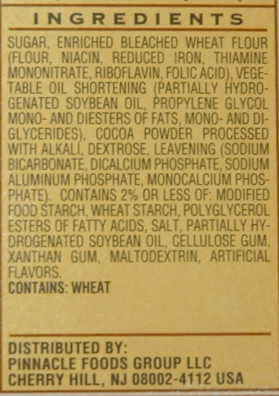
Notes:
Photograph of Pizza

Slide 3
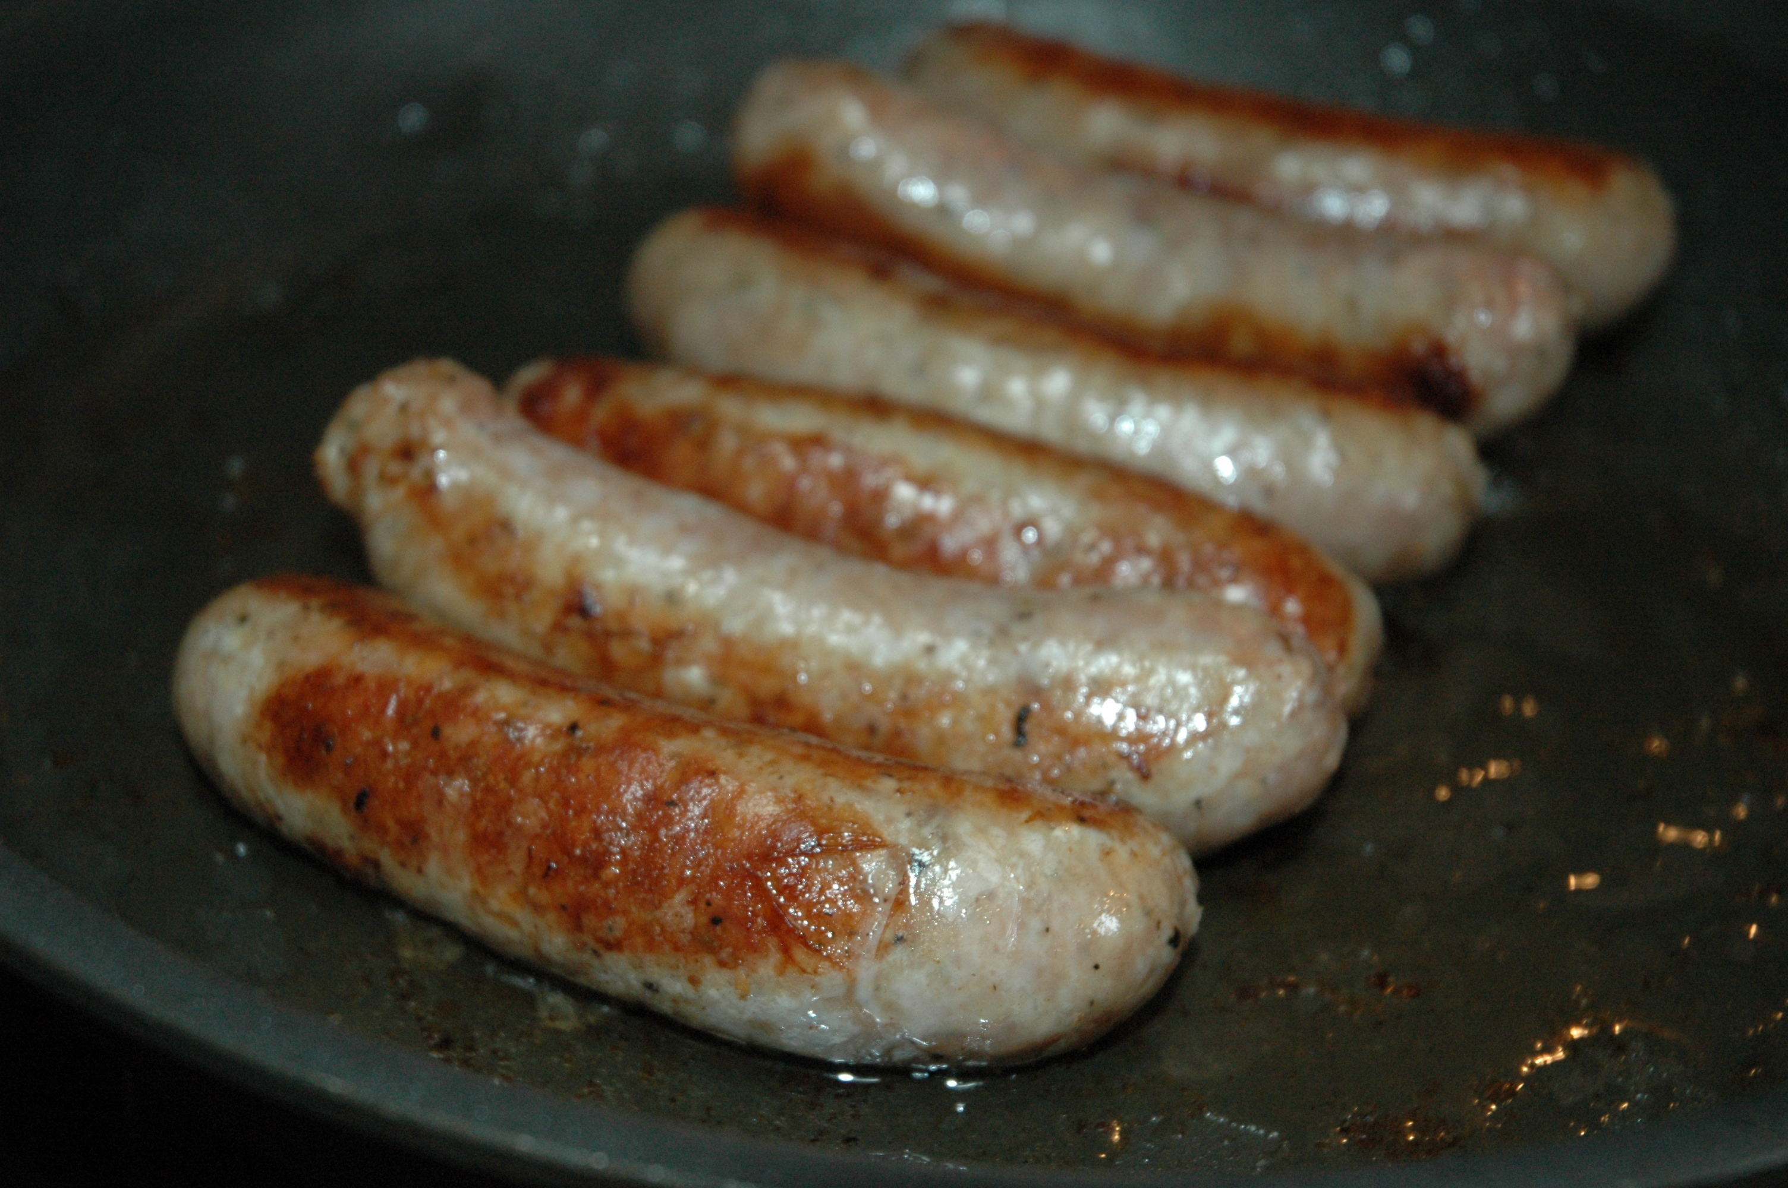
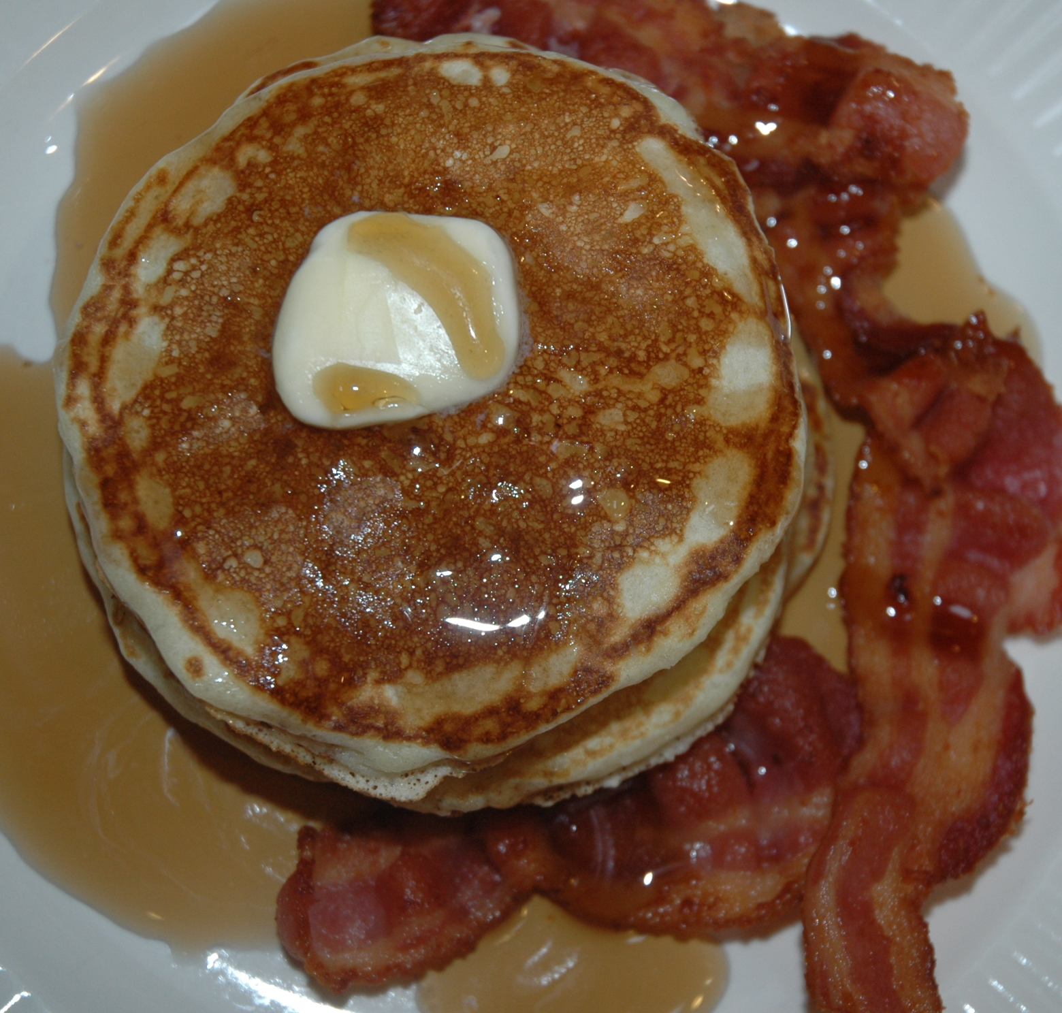
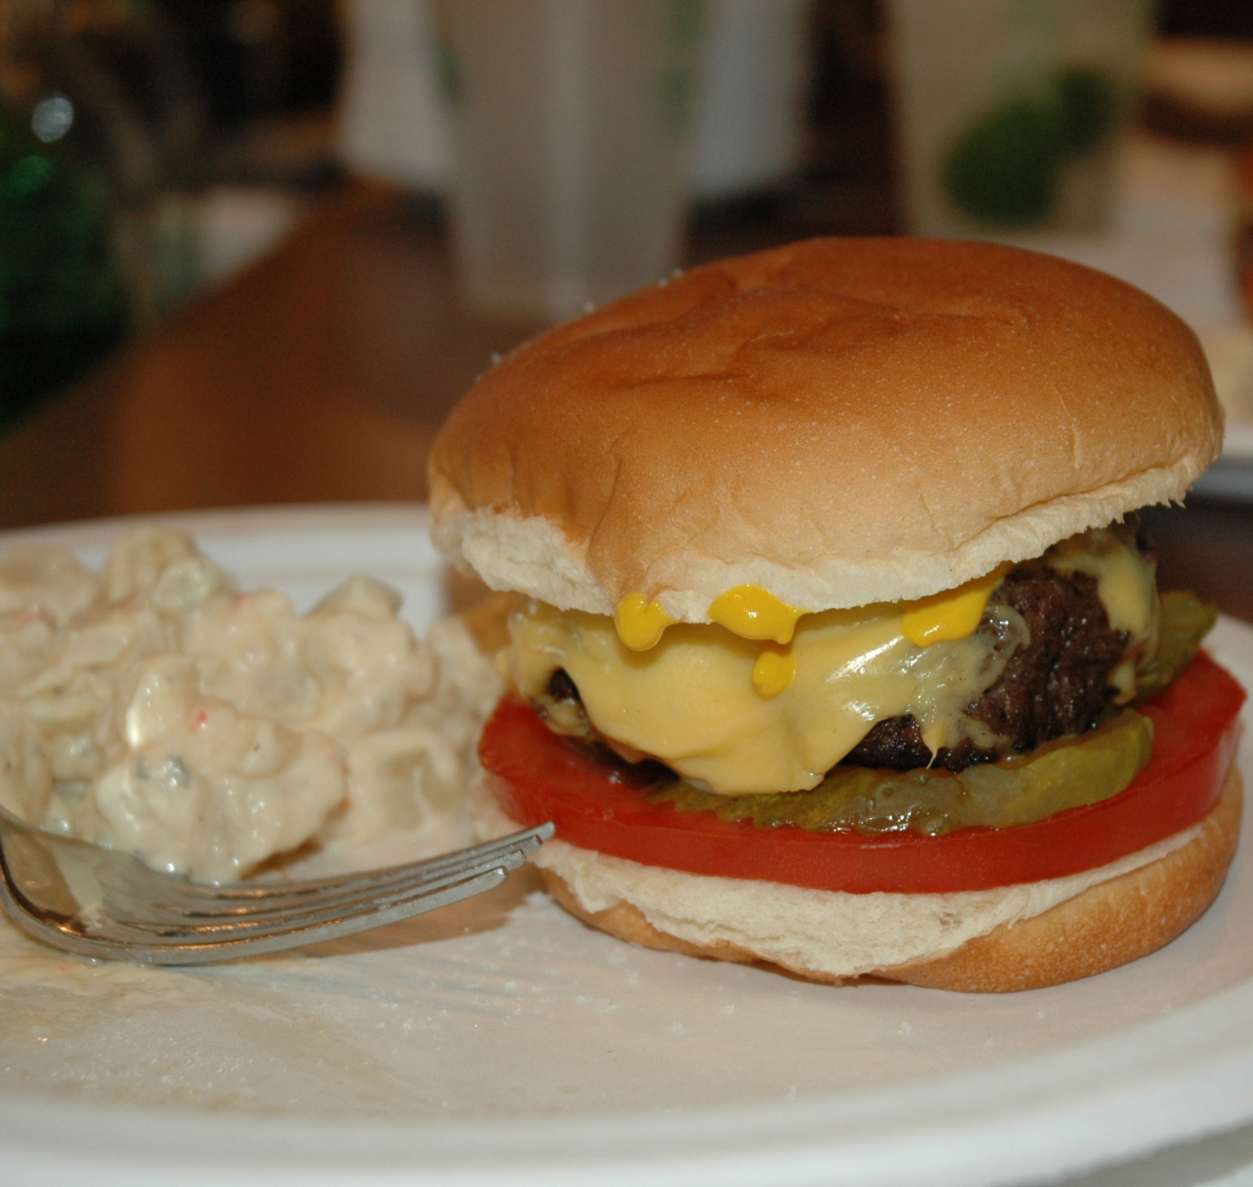
Genetically Modified
Organisms
Notes:
Genetically Modified Organisms - Visual Graphic

Slide 4
FOOD TECHNOLOGY

Slide 5
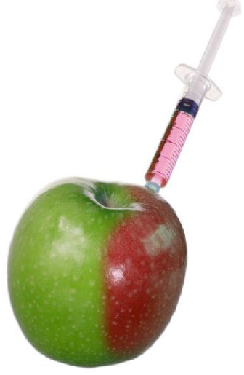
Food Technology
Genetically Modified Organisms
  Science of Change
  Purposes
Google Images

Slide 6
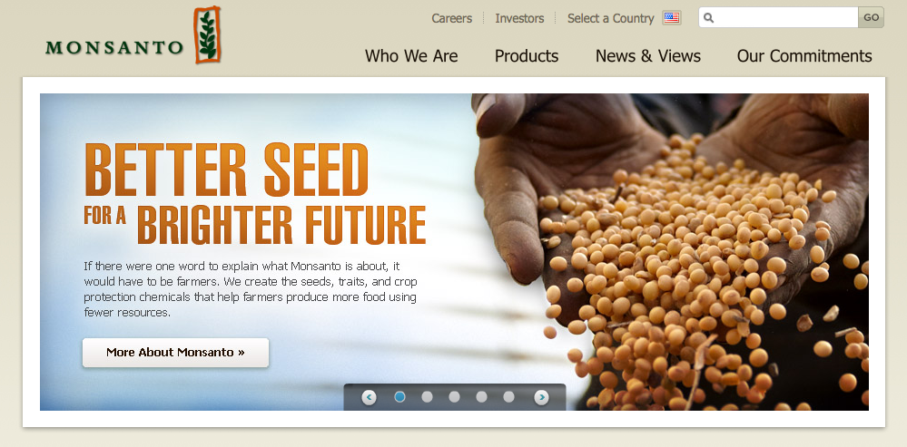
Monsanto
Agriculture, Pharmaceutical and Biotechnical
Monsanto.com

Slide 7
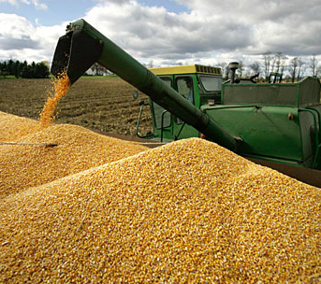
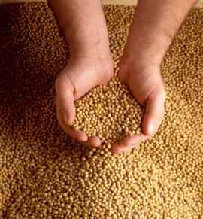
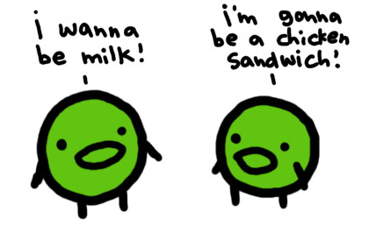
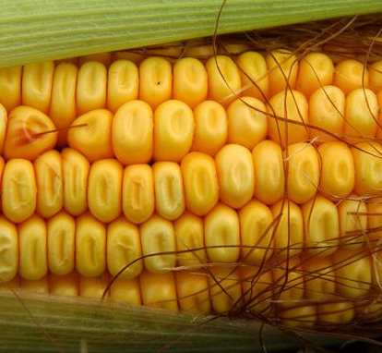
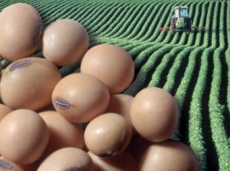
Major Cash Crops
Corn and Soybeans
Google Images

Slide 8
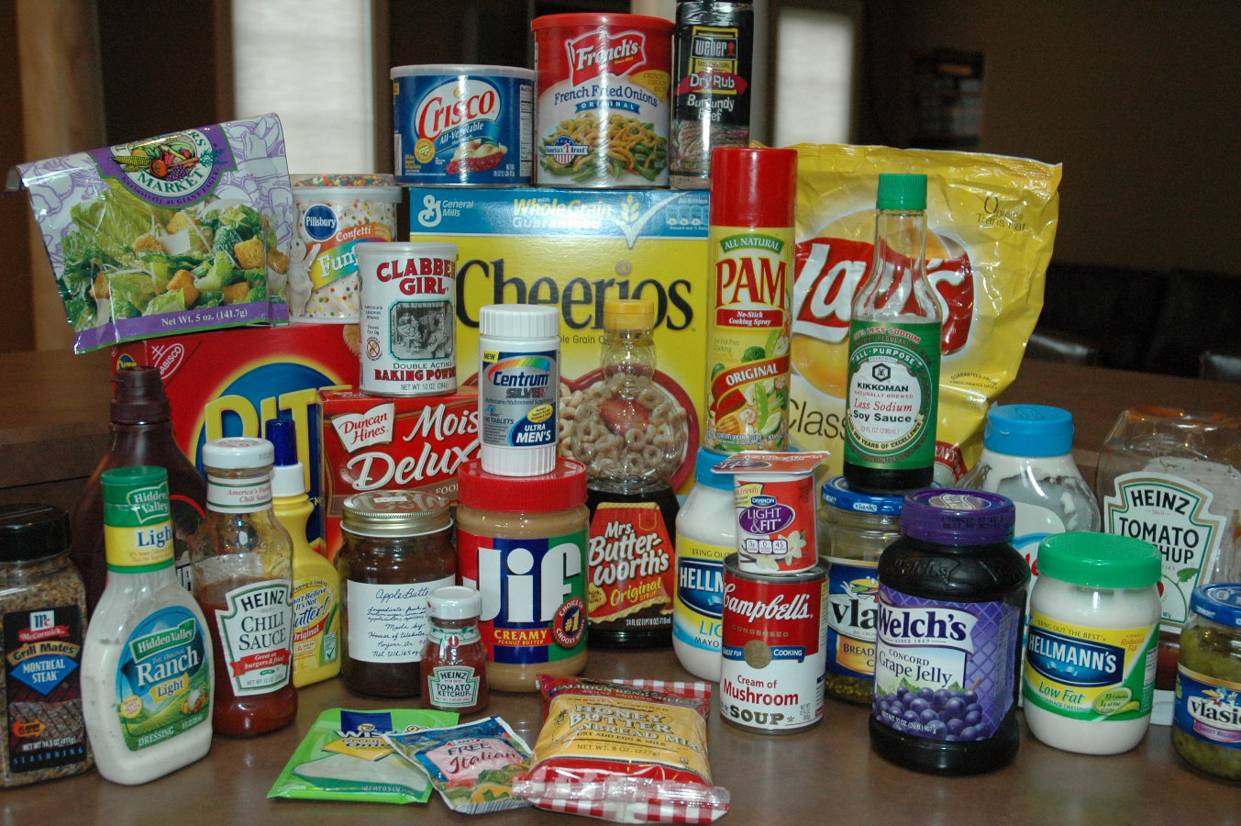
Products with soy & corn (34)

Slide 9
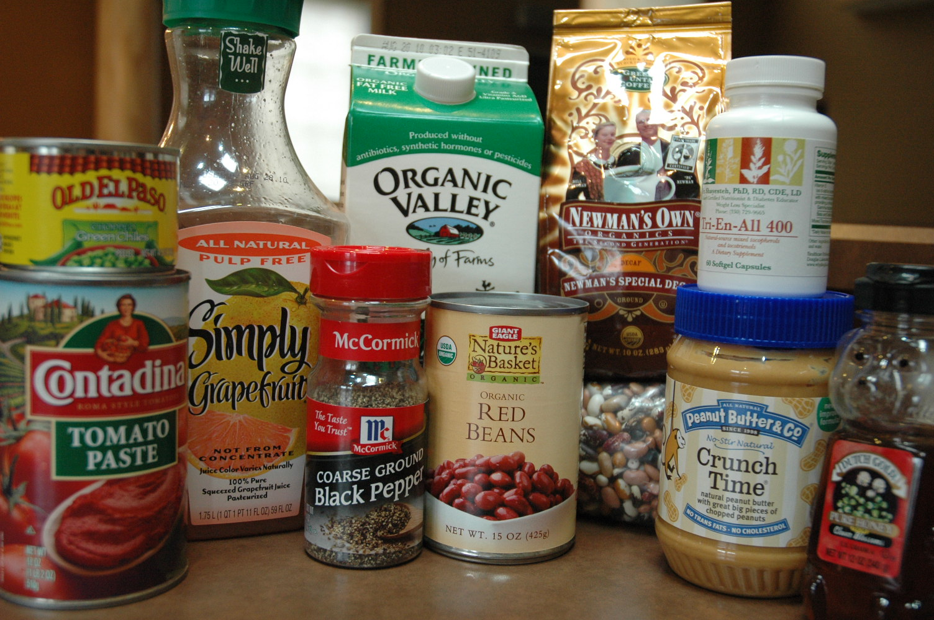
Products without soy & corn (11)

Slide 10
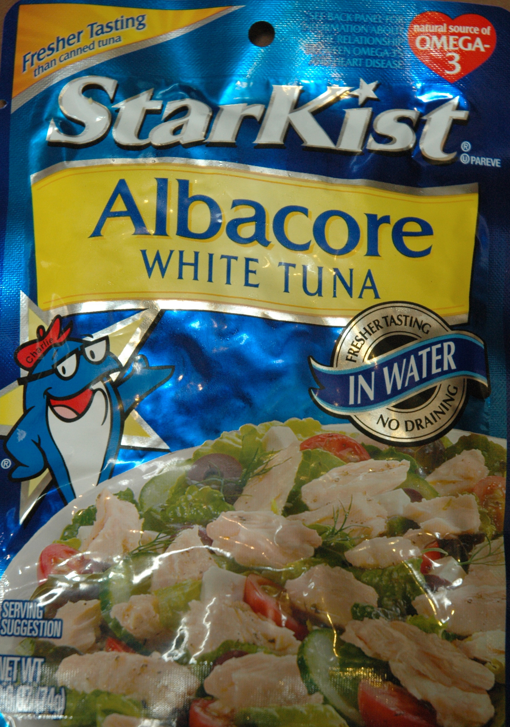
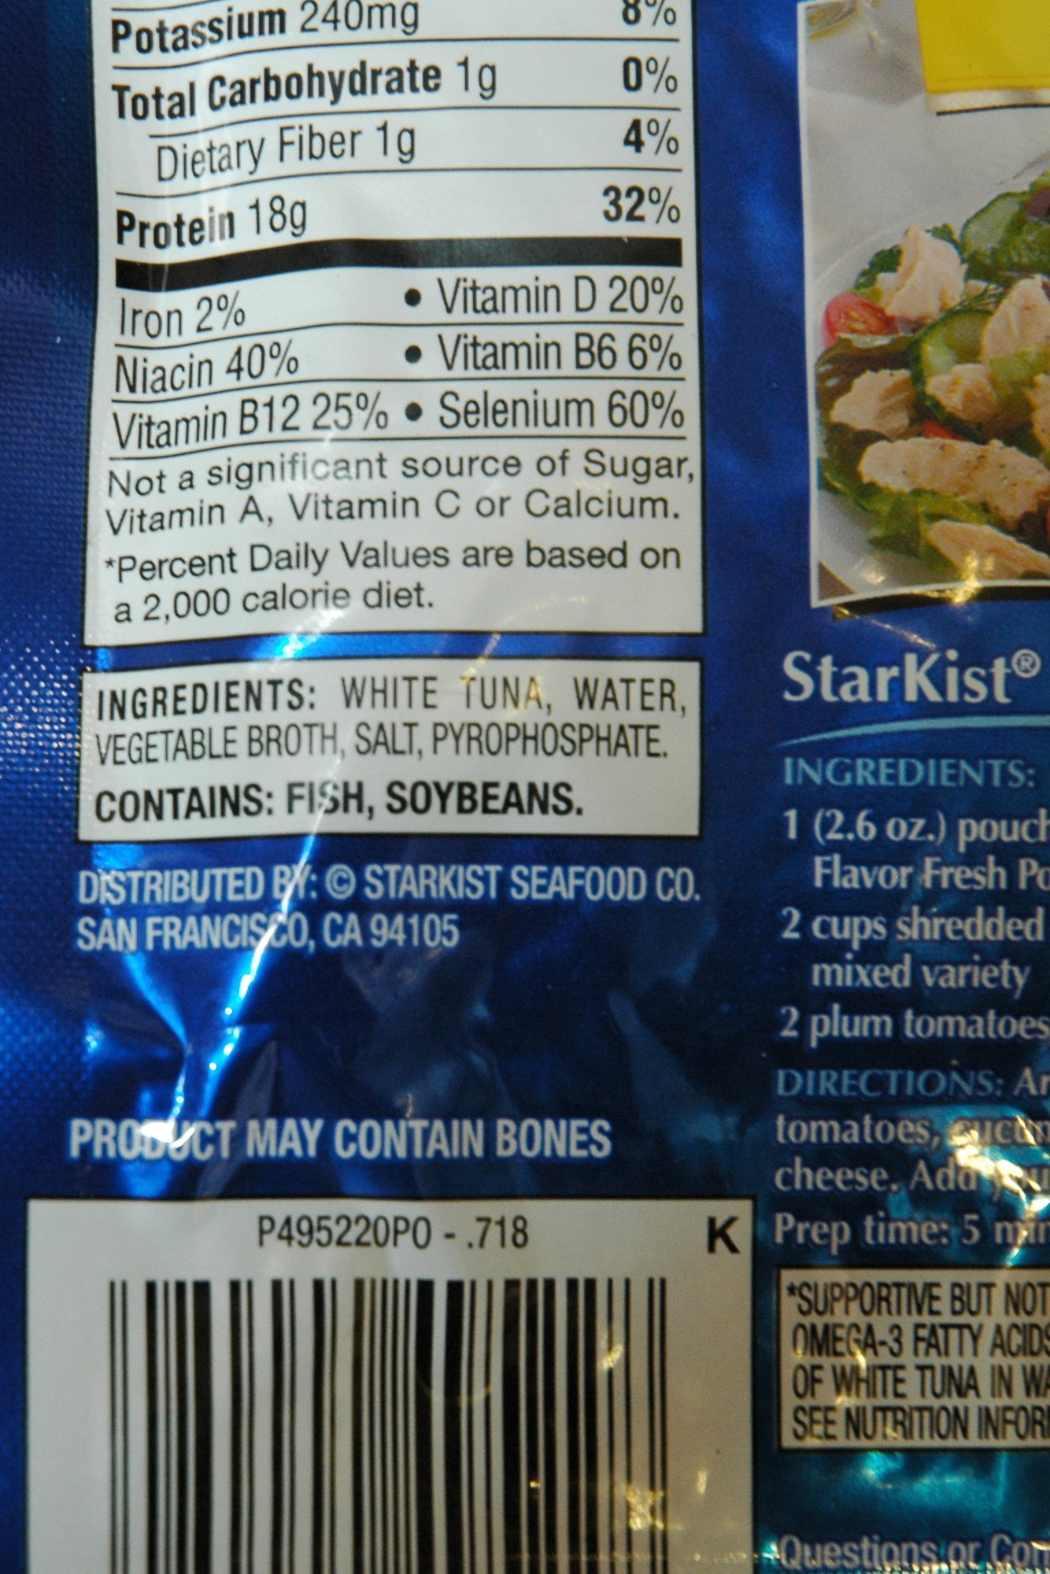
Surprise Product

Slide 11
Food Technology
Know the process
Be aware of GMOs and their food applications
Demand principles of sound science

Slide 12
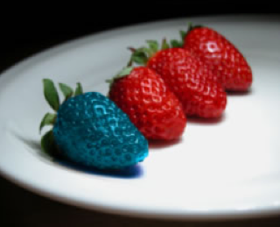
Google Images
Genetically Modified Organisms

