Slide 1
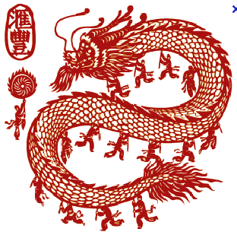
Negotiating China
Photo courtesy of Google Images
The shift to individualism

Slide 2
Individualism-Collectivism
Photo courtesy of Google Images
Socialization is learned from family
Cultural heritage across generations
Culture shapes who we are
Culture shapes individualism-collectivism

Slide 3
Conflict Behavior
Photo courtesy of Google Images
Incompatibility of values
Perceived or actual
Dyadic relationships

Slide 4
Facework
Photo courtesy of Google Images
Concept that originated with Chinese culture
Public image that people display
Self-construal
Independent versus interdependent
Chinese shift to independence

Slide 5
Ingroup/Outgroup Status
Photo courtesy of Google Images
Ingroup is where you belong
Outgroup is where you don’t belong
Conflict and outgroups
Default to learned behavior

Slide 6
Power Distance
Photo courtesy of Google Images
Distribution of power
America – small power distance
China – large power distance

Slide 7
Gender
Photo courtesy of Google Images
Greatly influences facework and conflict behavior
Men are more aggressive and competitive
Machiavellianism and Chinese men

Slide 8
Modernization
Photo courtesy of Google Images
Change in cultural landscape
Consequences of modernization
Culture under pressure
Convergence, divergence and crossvergence

Slide 9
Summary
Photo courtesy of Google Images
H1: Culture predicts individualism-collectivism
H2: Individualism-collectivism influences conflict
behavior.
H3: Modernization influences conflict behavior.
H4: Modernization influences individualism-
collectivism

Slide 10
Limitations and
Future Research
Photo courtesy of Google Images
Sibling status effect on conflict behavior
Combined effect of sibling status and gender on conflict behavior

Slide 11
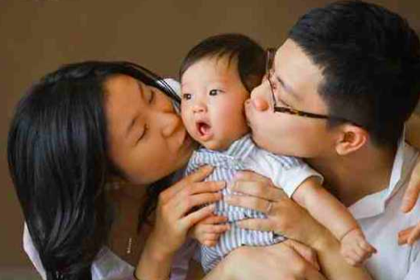
Only Children
Family interaction shapes conflict behavior
Less social competence
Effective adult communication
Self-seeking interests
Photo courtesy of Google Images

Slide 12
Same-gender Situations
Photo courtesy of Google Images
Gender differences are more pronounced
Men are competitive
Women are cooperative
Gender and status of opponent is key

Slide 13
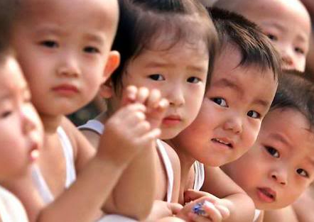
One Child Policy (OCP)
Photo courtesy of Google Images
China’s solution to overpopulation problem
Modifies the family composition
Boys are more valuable
Gender selection
Gender imbalance
Photo courtesy of Google Images

Slide 14
Research Questions
Photo courtesy of Google Images
RQ1: Will China’s OCP have an effect on conflict behavior, particularly as it applies to its creation of a society of male-dominant only children?
RQ2: Will China’s OCP be partially responsible for a shift from traditional collectivism to contemporary individualism?

Slide 15
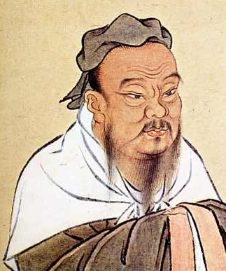
Conclusion
Photo courtesy of Google Images
“If I am not a man among men,
then what am I to be?”
- Confucius
Photo courtesy of Google Images

